Slide 1
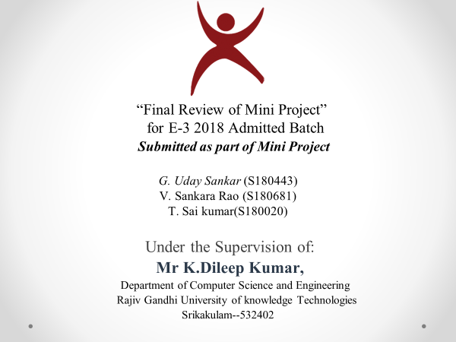

Slide 2

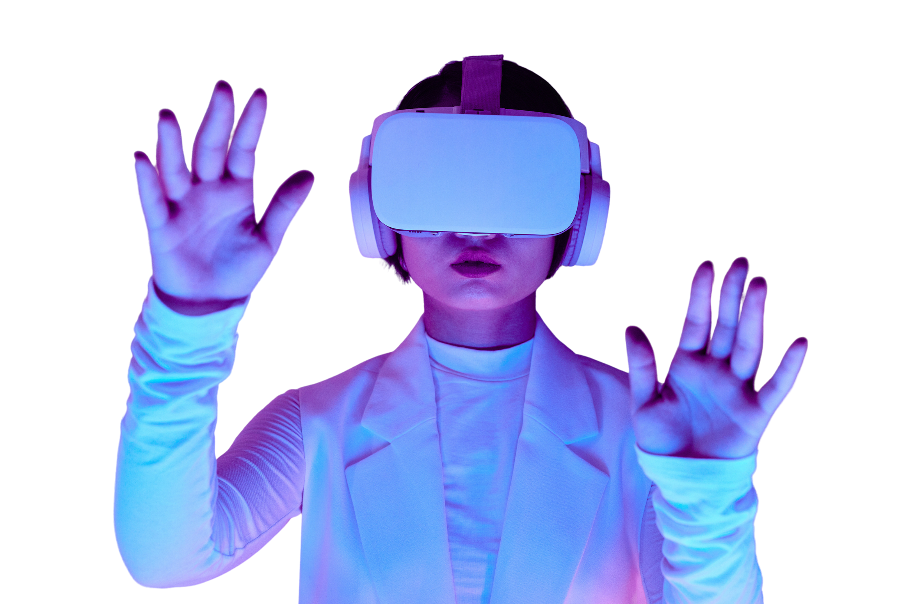


Live Lecture Visual Generation
ICT BASED

Slide 3
Table of Contents
Abstract
2. Problem Statement
3. Scope
4. Introduction
4. Analysis of existing system
5. Proposed System
6. Methodology
7. Results
8. Technologies & Libraries
9. Conclusion

Slide 4

Abstract:
This project aims to address the challenges faced by students in traditional lectures, such as struggling to keep up with the lecturer's pace and losing track of concepts due to lack of imagination and distractions. The existing Visual generation softwares like DreamCloud, Dall-e, and Deep-AI can only convert text into visuals, lacking the ability to recognize and convert live voice. To overcome this limitation, we are developing a system that recognizes the lecturer's voice, understands the lecture content, and generates visuals in real-time. The scope of this project includes using NLP, and graphical tools like Canvas. Through user testing and analysis of student engagement and learning outcomes, we will evaluate the effectiveness of the system. The goal is to significantly improve student engagement and learning outcomes compared to traditional lectures, potentially revolutionizing the delivery and reception of lectures in ICT (Information and Communication Technology)based education. This project will provide valuable insights into the use of NLP and Graphical tools, paving the way for new and innovative teaching methods.

Slide 5
Problem Statement:
The limited engagement and understanding in traditional lectures, due to the struggle of students to keep up with the pace and lack of imagination. Existing systems cannot convert live voice into visuals, hindering the creation of an interactive learning experience. This project aims to develop a system that recognizes the lecturer's voice, and Generates Effective Visuals, so that students can easily understand the lectures.

Slide 6
Scope:
1. Used for Conversion of Voice into effective Visuals
2. Lecturer’s can use this inorder to convert their voice into effective visuals, so that students can understand the lectures easily
3. It can be used mainly in Education sector this increases engagement of students with lectures and increases learning outcomes.

Slide 7
Introduction:
This project aims to develop a system that transforms traditional lectures into engaging and interactive animated visuals, addressing the challenges of student engagement and understanding. By combining NLP and graphical tools, the System recognizes the lecturer's voice, converts it into live animations, and evaluates its effectiveness in improving student learning outcomes. This innovative approach has the potential to revolutionize education by automating lectures and introducing new teaching methods.

Slide 8

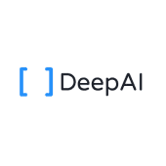

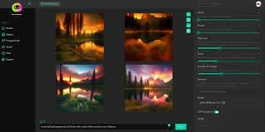
Analysis of Existing Systems
We Analyzed some of the existing applications like Dall-E,Deep.Ai,Dream Studio,Replicate these are the issues in Existing Assistants:
They are not able to understand/ Analyze Voice
They are not effective in Generating visuals using Voice

Slide 9
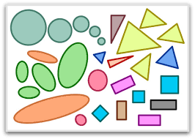
Proposed System
Our Proposed System overcomes the drawbacks of the existing systems.The advantages of our proposed system over existing system :
It can able to understand the voice
it can be able to generate the text using speech
it can able to generate the effective visuals using voice
it can able to generate the text into visual

Slide 10
Methodology
1. Speech Recognition:
The system should understand the lecturer’s voice and present it
as a text
2. Text Processing
The lecture text should be process and converted in a way to
represent data that could be understand by the system.
3. Data representation format
The data representation format that is considered in this project will
be hierarchy of class as follows:
Shape –> edge and angles -> points

Slide 11
4. canvas Visualization:
The data from data representation format will be visualized using the canvas tools in python.
5. Interface:
The interface which was created using tkinter is integrated with system inorder to show the visuals generated by the system.

Slide 12
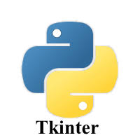
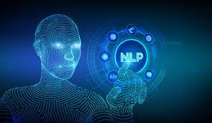
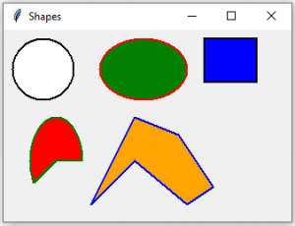

Technologies and Libraries:
Libraries:
SpaCy
Speech_recogniser
nltk
tkinter
PIL
shapely
math
random
string
Technologies:
Natural Language Processing
Graphical Tools- canvas
Python

Slide 13
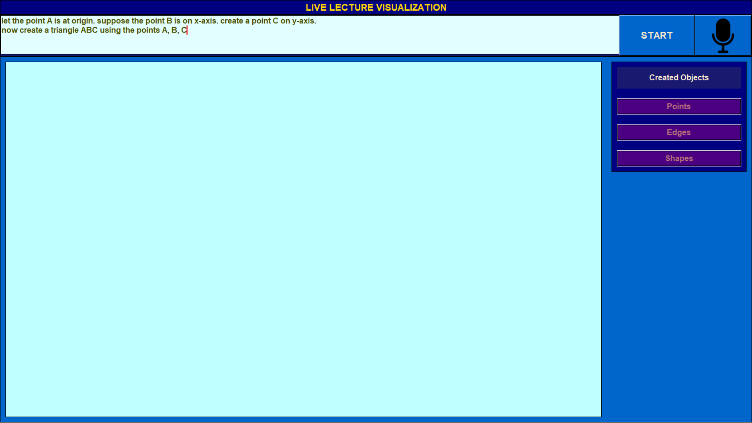
Results – Text Input
These are Results obtained by our system for a sample of text shown below

Slide 14
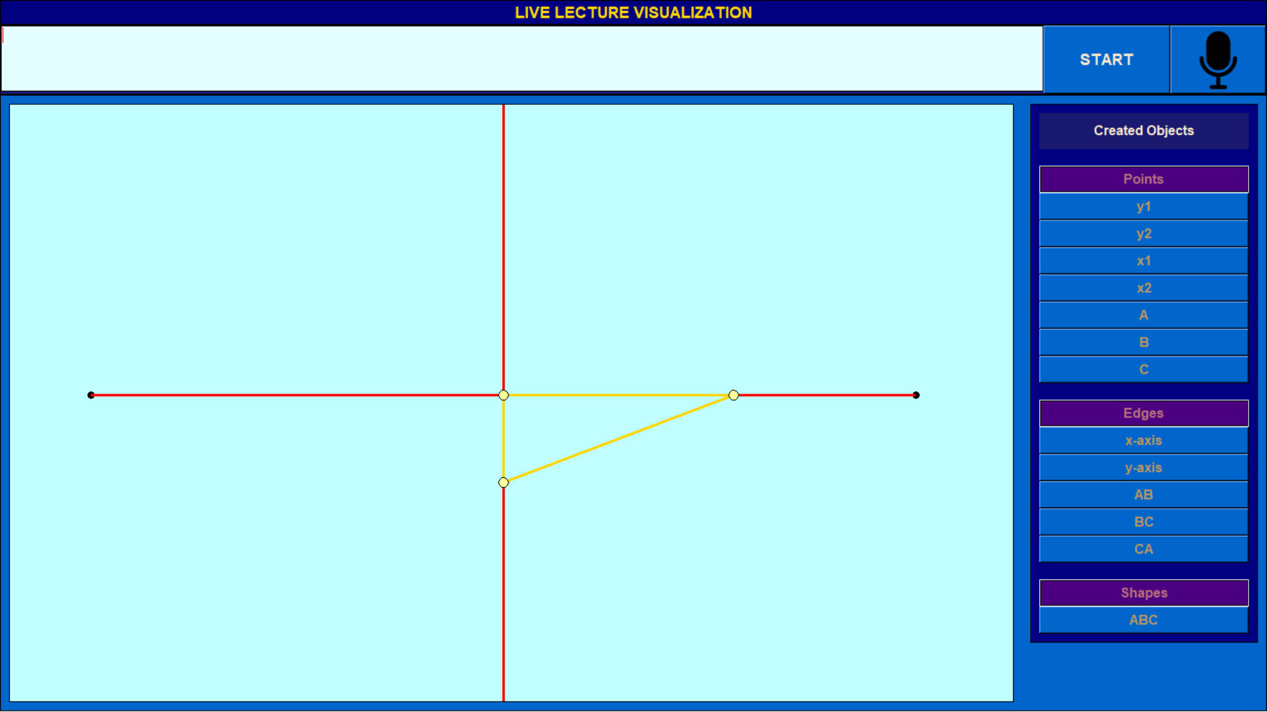
Output

Slide 15
References
https://arxiv.org/abs/2205.11487\
https://arxiv.org/abs/1406.2661
https://www.researchgate.net/publication/359441889_Text_to_Image_using_Deep_Learning
https://medium.com/mlearning-ai/10-best-free-to-use-text-to-image-generators-25743b3a5d50#17b3
https://en.wikipedia.org/wiki/Text-to-image_model#:~:text=A%20text%2Dto%2Dimage%20model,advances%20in%20deep%20neural%20networks
https://www.w3schools.com/python/python_regex.asp

Slide 16
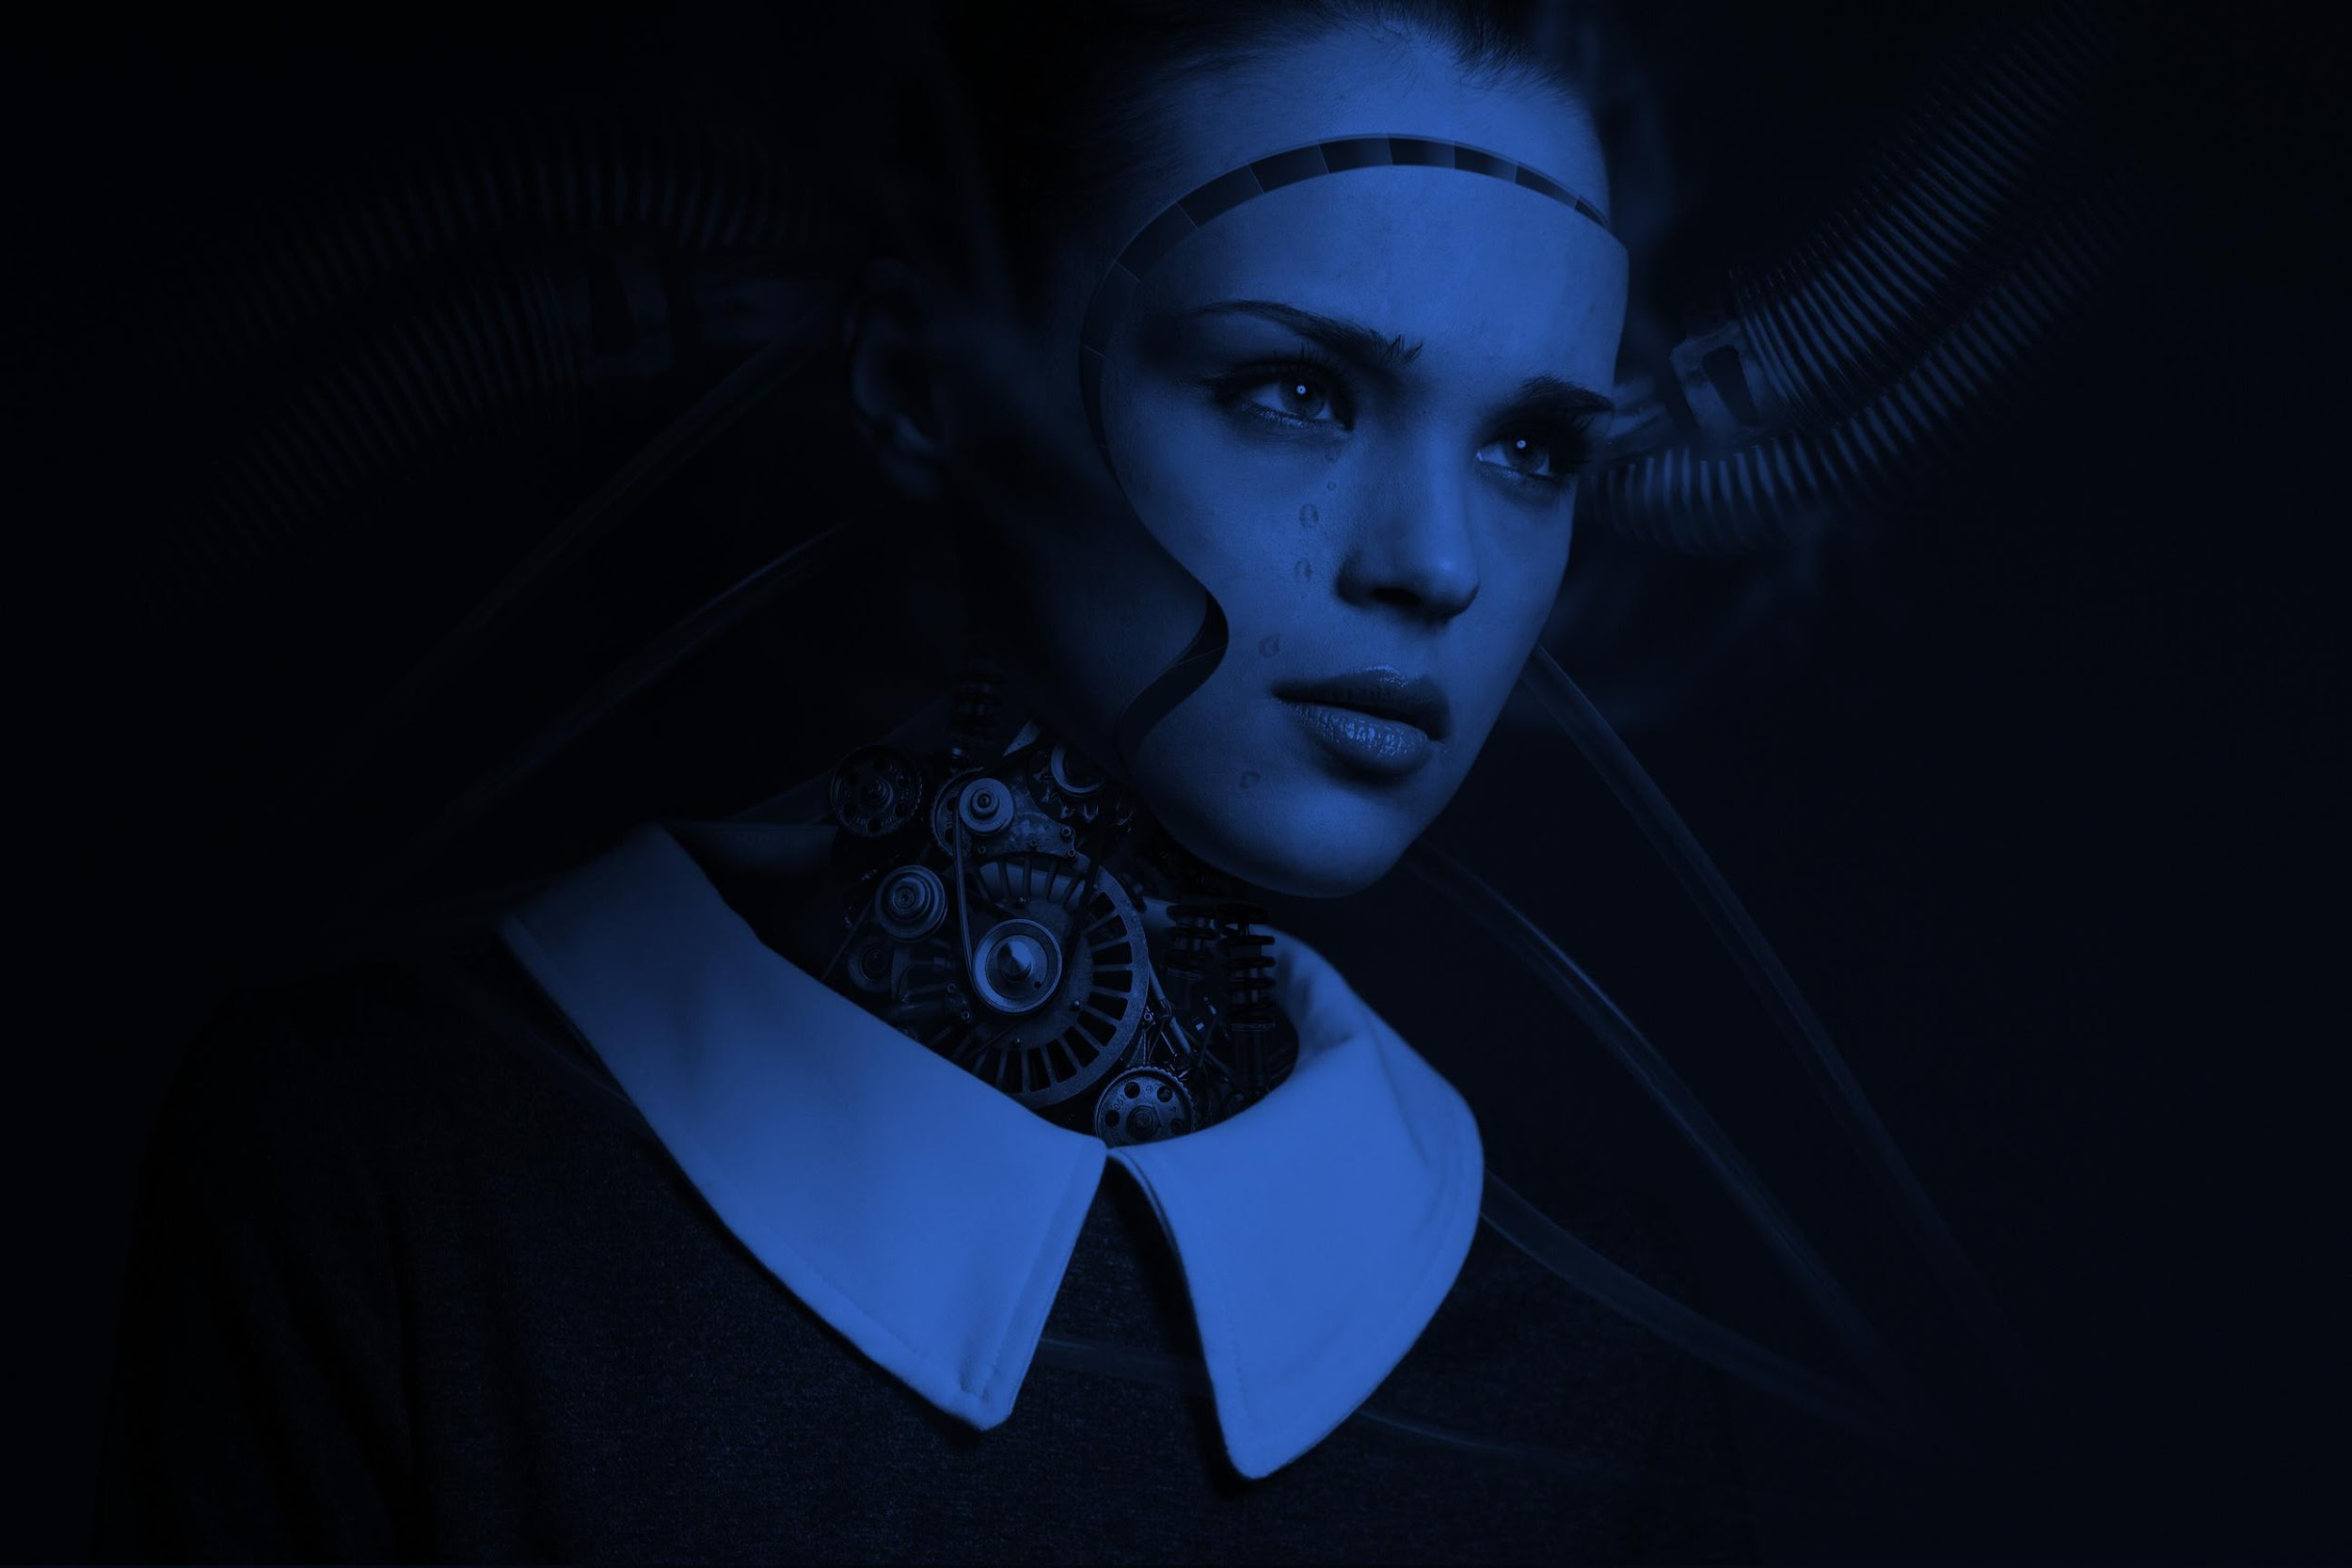

Conclusion
We Conclude that this project addresses the Problems of the existing Systems and it can be used to generate visual using Speech and also with the text. It addresses the Problems faced by the Students in the Traditional Lectures.

Slide 17
Thank You

